Slide 1
Randomized Algorithms

Slide 2
 | 确定性算法 deterministic algorithm | 随机算法 random algorithm
输入 | 输入数据 | 输入数据，随机数
输出结果和运行时间 | 同一组输入数据一样 | 同一组输入数据可能不一样
Average-case Analysis | 对输入数据平均 | 对随机数平均
本节的随机算法总是正确的，并且按预期有效运行
能解决如并行算法里面的死锁问题 symmetry-breaking distributed system

Slide 3


Randomized Algorithms
Hire an office assistant from headhunter
Interview a different applicant per day for N days
Interviewing Cost = C_{i} << Hiring Cost = C_{h}
Analyze interview & hiring cost instead of running time
Assume M people are hired.
Total Cost:

Slide 4

Randomized Algorithms
最简单的
如果比之前所有的好，就雇佣当前的
Worst case:
The candidates come in increasing quality order 会把所有人都雇佣下来了

Slide 5
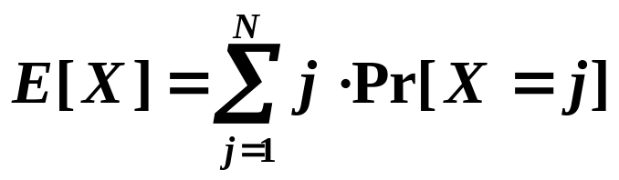
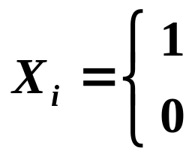
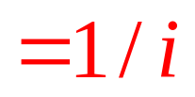
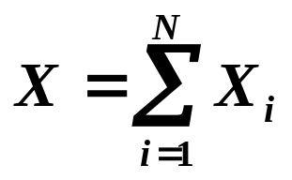
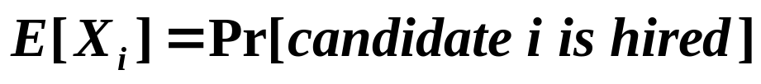
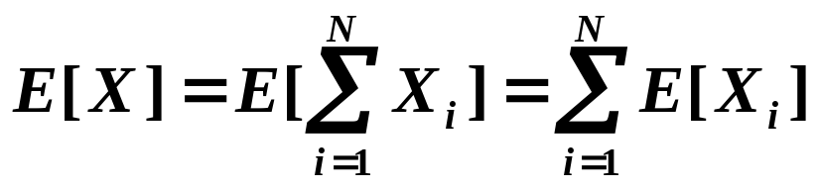
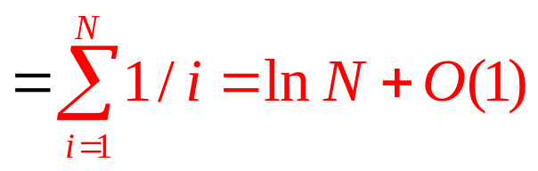
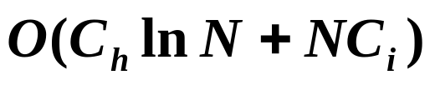
Randomized Algorithms
☞ Assume candidates arrive in random order
X = number of hires
if candidate i is hired
if candidate i is NOT hired
是最强的概率是1/N

Slide 6
Randomized Algorithms
Online Hiring Algorithm – hire only once
int OnlineHiring ( EventType C[ ], int N, int k )
{
int Best = N;
int BestQ = - ∞ ;
for ( i=1; i<=k; i++ ) {
Qi = interview( i );
if ( Qi > BestQ ) BestQ = Qi;
}
for ( i=k+1; i<=N; i++ ) {
Qi = interview( i );
if ( Qi > BestQ ) {
Best = i;
break;
}
}
return Best;
}

Slide 7
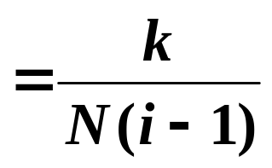
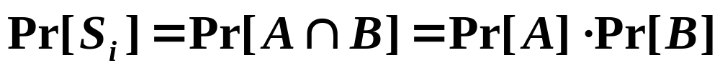


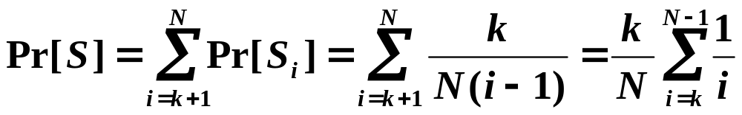
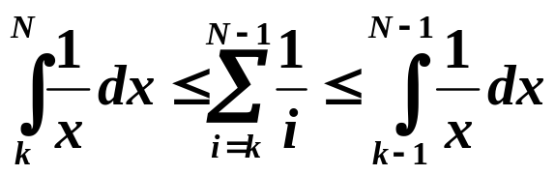
Randomized Algorithms
Online Hiring Algorithm
S_{i} := the ith applicant is the best
What needs to happen for S_{i} to be TRUE?
independent
{ A:= the best one is at position i }
∩ { B:= no one at positions k+1 ~ i–1 are hired }

Slide 8

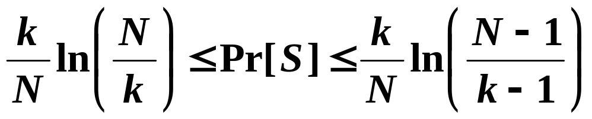
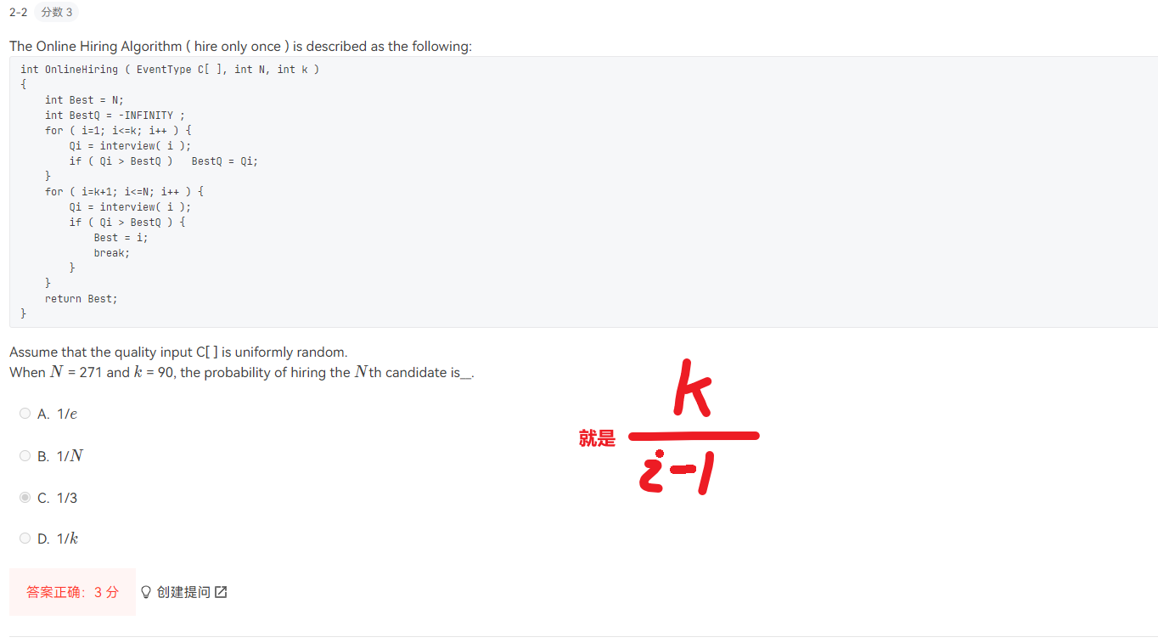
Randomized Algorithms
What is the probability we hire the best qualified
candidate for a given k?

Slide 9

Randomized Algorithms
▪ Deterministic Quicksort
☞ Θ(N²) worst-case running time
☞ Θ(N log N) average case running time, assuming
every input permutation is equally likely
 How about choosing the pivot uniformly at random?
Central splitter := the pivot基准 that divides the set so that each side contains at least n/4
Modified Quicksort := always select a central splitter before recursions

Slide 10
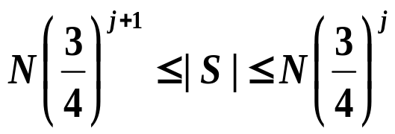
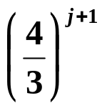
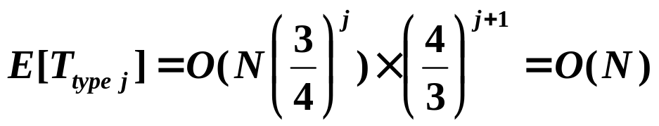


Randomized Algorithms
Claim: The expected number of iterations needed until we find a central splitter is at most 2.
N/4
N/4
N/2 central splitters
Pr[ find a central splitter ] = 1/2
✓
Type j : the subproblem S is of type j if
Claim: There are at most subproblems of type j.
Number of different types =

